Slide 1









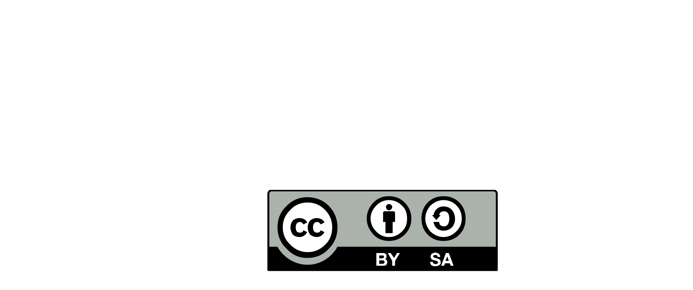

Data
expert
Tech.
expert
Communities
Of
Practices
Architecture
Community
EXPERTISE
MOBILIZE EXPERTISE
CAPITALIZE
Security
expert
Infra.
expert
REFERENCE ARCHITECTURE
SYSTEM ENGINEERING
INTEGRATION STRATEGY
TECHNOLOGY STACK
PATTERNS & PRINCIPLES
TECH RADAR
STANDARDS
BLUEPRINTS
IS
PORTFOLIO
FULL STACK
ARCHITECT
GLOBAL TECHNICAL DEBT
TECHNOLOGY ROADMAP
IS ROADMAP
TECH SOLUTION
PROVIDERS
Business
Domain
IT PLATFORMS
STUDY & SELECT
ASSEMBLE COMPONENTS
SERVICE LEVEL & NFRs
PRODUCT EVOLUTION
END USER PROBLEM SOLVING
ARCHITECTURE RUNWAY
TECHNICAL DECISIONS
NON-FUNCTIONAL REQUIREMENTS
TECHNICAL DEBT
CONNECT THE DOT
FULL STACK DESIGN
FAILURE MODE & EFFECT ANALYSIS
RCA ANALYSIS
LISTEN OPERATIONS
EVOLUTIONARY ARCHITECTURE
TECH PRINCIPLES & PATTERNS
TECH STACK
TEAM
LEADER
UX
TEAM
LEADER
DELIVERY
SQUAD
TEAM
LEADER
UX
DELIVERY
SQUAD
DELIVERY
SQUAD
TECH
LEAD
DEV.
TECH
LEAD
DEV.
TECH
LEAD
DEV.
END USER*
- CLIENT
- BUSINESS
- EMPLOYEE
- PARTNER
UX
FULL STACK ARCHITECT
DESIGNED BY :

